Slide 1

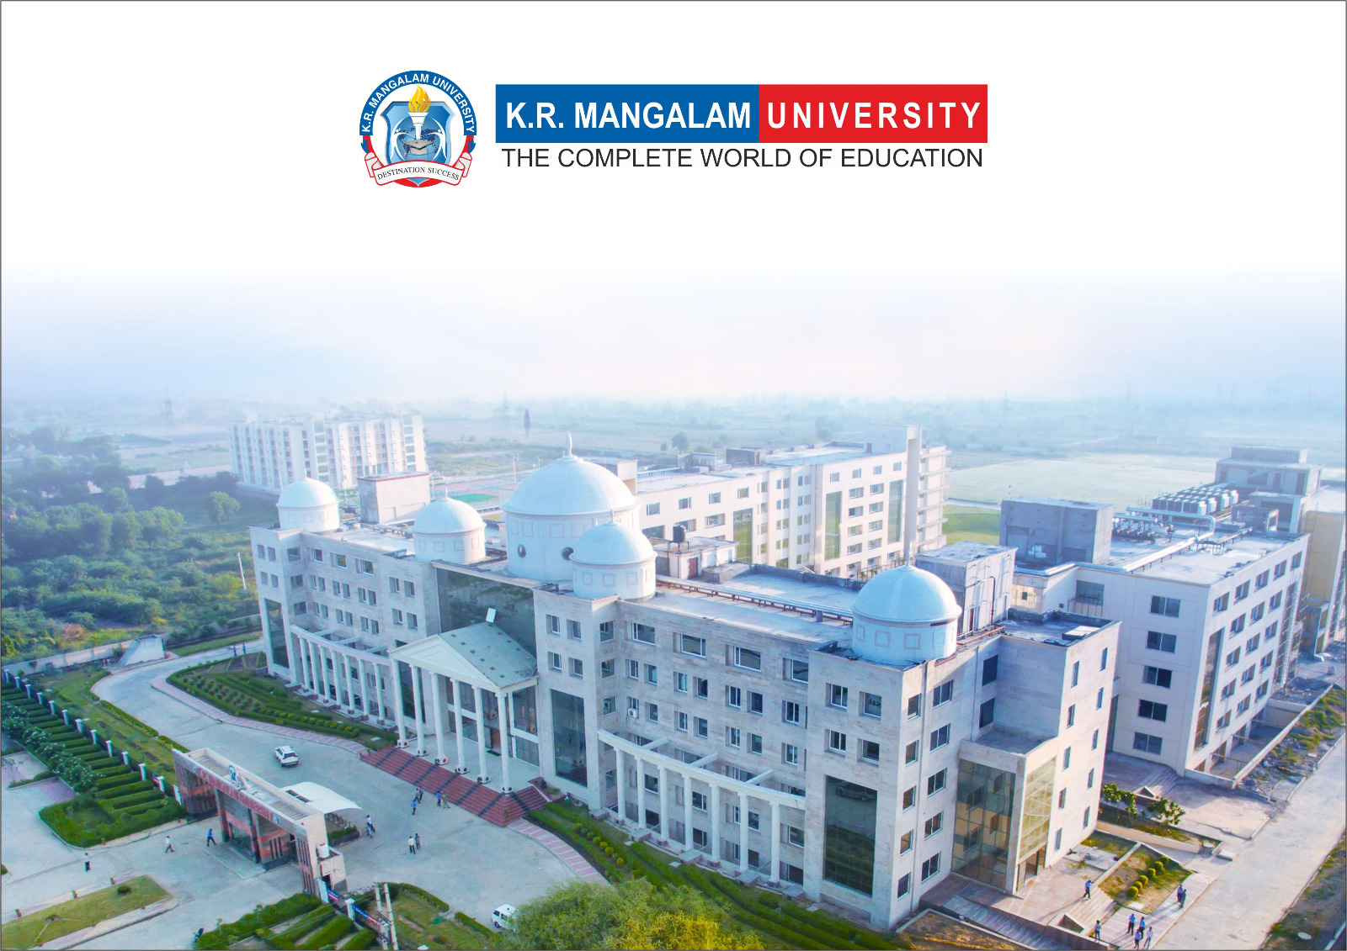
Introduction to Water Chemistry & Hardness
Course Code: ETMLCH104
Course Name: Engineering Chemistry
Program: B.Tech. (AI/ML)
Unit1:Water technology & Chemical Fuels
Dr Pratibha Sharma
Assistant Professor, Department of Chemistry
School of Basic and Applied Sciences
K.R. Mangalam University
Sohna Road, Gurugram

Slide 2

Course Overview
Unit Number: 1 | Title: Water technology | No. of hours: 6
Introduction, water analysis: Hardness-determination by EDTA method, Treatment of boiler feed water: Internal treatment (Phosphate, Colloidal and Calgon conditioning). External treatments: Ion exchange and lime-soda process, Zeolite processes. Boiler scales formation and ill effects, methods of prevention of scales. Numerical problems
Unit Number: 2 | Title: Chemical Fuels | No. of hours: 9
Fuels: Introduction, classification, calorific value (HCV & LCV), Determination of calorific value of fuel using Bomb calorimeter. Solid fuel: Coal- its analysis by proximate and ultimate analysis, Numerical problems. Liquid fuels: Refining of petroleum, Petroleum cracking, Knocking in IC engine, its ill effects and prevention of knocking. Anti-knocking agent: Leaded and unleaded petrol. Gaseous fuels: LPG, CNG and their applications.
Unit Number: 3 | Title: Battery Technology | No. of hours: 10
Introduction - Galvanic cell, electrode potential, EMF of the cell and cell representation. Batteries and their importance, Classification of batteries- primary, secondary and reserve batteries with examples. Battery characteristics - voltage, capacity, energy density, power density, energy efficiency, cycle life and shelf life. Construction, working and applications of: Ni-Cd, and Lithium-ion battery. Working principle of an electric vehicle.
Unit Number: 4 | Title: Polymer | No. of hours: 5
Basic concepts of polymer, Types of polymers, Thermoplastic & thermosetting plastics, Preparation and application of some industrially important polymers (Natural rubber, Buna S, Buna-N, Neoprene, Isoprene, Nylon-6, nylon-6,6 , Decron and Terylene). Conducting and biodegradable polymers.

Slide 3
COURSE OUTCOMES
CO1: Understand the methods for water hardness and the basics of boiler water treatment and analyze fuel calorific values and battery.
CO2: Explain the characteristics and working principles of different battery types and types of fuels.
CO3: Determine the differences between batteries and fuel cells and classify fuel cell types based on their components..
CO4: Identify between hard and soft water, solve the related numerical problems on water purification and emf and its significance in industry and daily life.

Slide 4
Introduction to Water Chemistry & Hardness
Revision

Slide 5
1. Water Hardness
Definition: Hardness is the property of water that prevents lather formation with soap. It's caused by dissolved polyvalent metal ions, primarily calcium (Ca 2+ ) and magnesium (Mg 2+ ).
Determination: The EDTA (Ethylenediaminetetraacetic acid) method is used. EDTA forms a stable complex with the metal ions.
Indicator: Eriochrome Black T (EBT) is used.
Principle: At pH 10, EBT forms a wine-red complex with Ca 2+ and Mg 2+ . As EDTA is added, it replaces the EBT, forming a more stable colorless complex. The endpoint is reached when the color changes from wine-red to a sharp steel-blue.
Calculation: The amount of EDTA used is proportional to the hardness of the water.

Slide 6
2. Boiler Feed Water Treatment
Why treat? Untreated water can cause serious issues in boilers, including scale formation, corrosion, and priming/foaming, which decrease efficiency and can lead to explosions.
Boiler Scales: These are hard, adherent deposits formed on the inner surfaces of boilers.
Formation: They form due to the decomposition of bicarbonates and the precipitation of calcium sulfate (CaSO4​) and calcium silicate (CaSiO3​).
Ill Effects:
Reduced Heat Transfer: Scales are poor conductors of heat, leading to fuel wastage and overheating of boiler parts.
Boiler Explosion: Overheating can weaken the boiler material, causing it to fail under pressure.
Corrosion: Scales can form a layer that hides and promotes localized corrosion underneath.

Slide 7
2. Boiler Feed Water Treatment
Prevention:
Internal Treatment: Chemicals are added directly to the boiler water.
Phosphate Conditioning: Sodium phosphate is added to precipitate calcium and magnesium salts as soft sludge that can be easily removed by blowdown.
Colloidal Conditioning: Organic colloids like tannin or agar-agar are added to coat the scale-forming particles, preventing them from sticking to the boiler surfaces.
Calgon Conditioning: Calgon (sodium hexametaphosphate) is used to sequester or "trap" calcium and magnesium ions, preventing them from precipitating.

Slide 8
4. External Treatment
External Treatment: Water is treated before it enters the boiler.
Lime-Soda Process: Slaked lime (Ca(OH)2​) and soda ash (Na2​CO3​) are added to precipitate calcium and magnesium ions as insoluble carbonates and hydroxides.
Zeolite (Permutit) Process: This involves passing water through a bed of zeolite (hydrated sodium aluminosilicate). Sodium ions in the zeolite are exchanged for calcium and magnesium ions in the hard water, softening it. The exhausted zeolite can be regenerated by passing a concentrated brine (NaCl) solution.
Ion Exchange Process: This is a more advanced method using synthetic resins. Cation exchange resins replace Ca2+ and Mg2+ with H+ ions, while anion exchange resins replace anions like Cl− and SO42−​ with OH− ions. The H+ and OH− ions combine to form water, resulting in demineralized (or deionized) water.

Slide 9

Quiz
Q1 The maximum desirable limit of total hardness (as CaCO₃) in drinking water
800
600
300
400
Q2 Permanent hardness of water is caused by the presence of
A) Chlorides of Ca & Mg
b) Sulphates of Ca & Mg
C) Bicarbonates of Ca & Mg
D) Carbonates of Na & K
Q3 Permanent hardness of water may be removed by the addition of
A) Lime
B) Sodium bicarbonate
C) Soda Ash
D) Potassium permanganate

Slide 10
Quiz
Q4 Zeolite softening process removes both temporary and permanent hardness of water. In this process the calcium and magnesium present in water are precipitated as
Insoluble carbonates
Insoluble chlorides
Insoluble sulphates
Insoluble zeolites
Q5 The process in which water is passed through filter beds of sand and gravel to remove smaller particles of dust is called
A) Sedimentation
B) Filtration
C) Cogulation
D) Chlorination

Slide 11
Quiz
Q6 In determination of water hardness by complexometric titration at what pH which indicator is used
Methyl orange at 4-5 pH
Methyl orange at 9-10 pH
Eriochrome Black - T at 4-5 pH
Eriochrome Black - T at 9-10 pH
Q7 What is the correct relationship between various unit of hardness
A) 1ppm=0.1mg/l=0.1degree F= 0.07degree Cl
B) 1ppm=0.01mg/l=0.1 degree F=0.7 degree Cl
C) 1ppm=.01mg/l=0.1 degree F = 0.07 degree Cl
D) 1 ppm= 1 mg/l=0.1degree F= 0.07 degree Cl

Slide 12
Quiz
Q8 The most common cause of acidity in water is
Rain Water
River Water
Pond Water
Well Water
Q9 Which of the following represents the physical characteristics of water?
A) Chloride
B) BOD
C) Turbidity
D) COD
Q10 In water treatment which factor which has a major control over reaction selectivity and product distribution?
A) pH
B) Temperature
C) Pressure
D) ionic concentration

Slide 13
References
Textbooks:
Engineering Chemistry by P.C. Jain & M. Jain, Dhanpat Rai Publishing Company (P) Ltd, 16thEdition, New Delhi.
Engineering Chemistry by Prasanta Rath, B. Rama Devi, C. H. Venkata Ramana Reddy, Subhendu Chakroborty, Cengage Learning Publication, India Private Limited , 2018.
Online Courses:
https://nptel.ac.in/courses/105106119
https://www.youtube.com/watch?v=CWOJW4357Bg

